Slide 1
Software Engineering CS – 303
Lecture no. 3. “Software Process Models (Cont’)”
Week no. 2

Slide 2
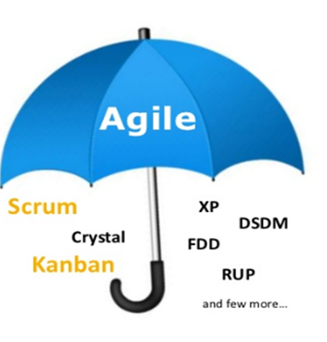
Agile Development
Agile software development is an umbrella term for a set of methods and practices based on the values and principles expressed in the Agile Manifesto.
Solutions evolve through collaboration between self-organizing, cross functional teams utilizing the appropriate practices for their context.

Slide 3
Agile Methodologies
Scrum
Dynamic System Development Methodology
Extreme Programming
Test Driven Development
Lean
Kanban

Slide 4
Scrum
A framework within which people can address complex adaptive problems, while productively and creatively delivering products of the highest possible value.
The Scrum framework consists of Scrum Teams and their associated roles, events, artifacts and rules that bind them together.

Slide 5
Scrum
A light weight Agile process framework
Split your organization into small, cross-functional, self-organizing teams
Split your work into a list of small, concrete deliverables, sort the list by priority and estimate the relative effort of each item
Split time into short fixed-length iterations/sprints (usually 2-4 weeks), with potentially shippable code demonstrated after each iteration
Optimize the release plan and update priorities in collaboration with the customer, based on insights gained by inspecting the release after each iteration
Optimize the process by having a retrospective after each iteration

Slide 6
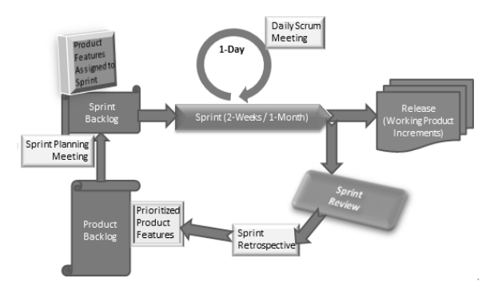
Scrum Process Framework

Slide 7
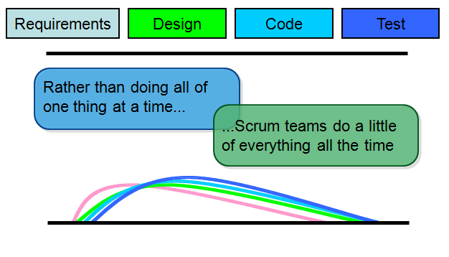
Sequential vs. overlap

Slide 8
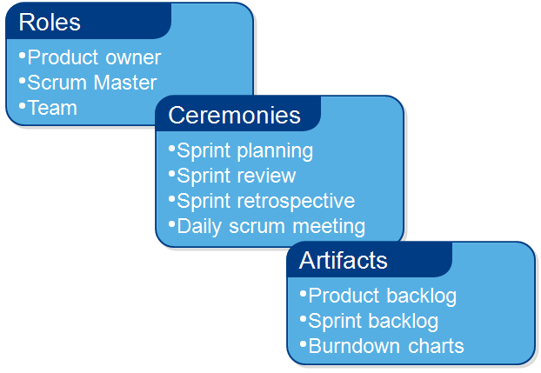
Scrum Framework

Slide 9
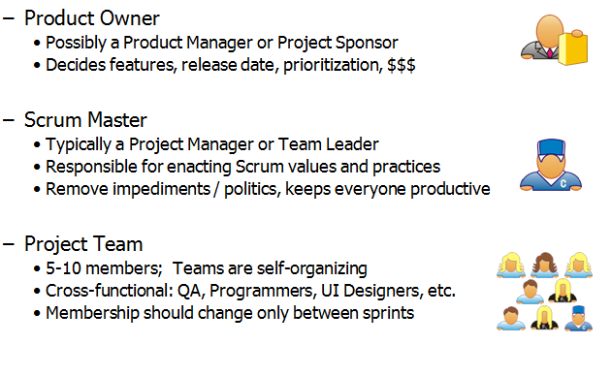
Scrum Roles

Slide 10
Scrum Master Services
Scrum Master services to the Product Owner
Finding techniques for effective Product Backlog management
Helping the Scrum Team to understand the need for clear and concise Product Backlog items
Understanding the product planning in an empirical environment
Ensuring that the Product Owner knows how to arrange the Product Backlog to maximize value
Understanding and practicing agility
Facilitating scrum events as needed

Slide 11
Scrum Master Services
Scrum Master services to the Scrum Team
Coaching the scrum team in self organization and cross functionality
Helping the scrum to create high value products
Removing impediments to the Scrum Team’s progress
Facilitating Scrum events as requested or needed
Coaching the Scrum Team in organizational environments in which Scrum is not yet fully adopted and understood

Slide 12
Scrum Master Services
Scrum Master services to the Organization
Leading and coaching the organization in its Scrum adoption
Planning Scrum implementations with in the organization

Slide 13
Events/Ceremonies
The Sprint
Sprint Planning
Daily Scrum Meetings Time-boxed
The Sprint Review
The Sprint Retrospective

Slide 14
Events/Ceremonies
Sprint
Two to four weeks duration
A definition of what is to be built, a design
A flexible plan that will guide in development
The resultant product increment
Sprint should be cancelled if its goal becomes obsolete – can be cancelled only by Product Owner

Slide 15
Events/Ceremonies
Sprint Planning
What needs to be and can be delivered in the Sprint Increment?
How will the work needed for the execution of Sprint be achieved?
Inputs to this meeting are:
Product Backlog
Latest Product Increment
Past performance of the team

Slide 16
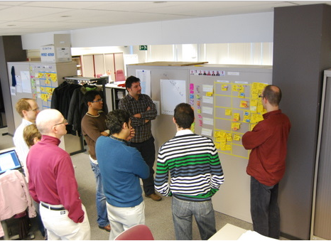
Daily Scrum Meeting
Parameters
Daily 15 minutes, stand-up
Scrum master, product owner do the talking
Questions asked:
What did you do yesterday?
What will you do today?
What obstacles are in your way?

Slide 17
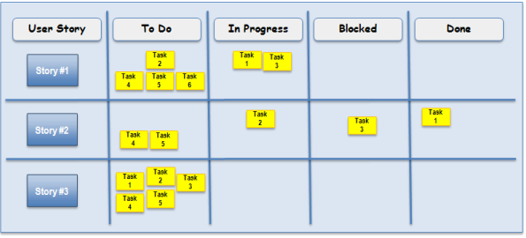
Daily Scrum Meeting

Slide 18
Sprint Review
Held at the end of every Sprint
Released increment is reviewed
The team and the stakeholders collaborate to understand what was done in the Sprint
Held for two hours for two week Sprints and four hours for one month Sprints

Slide 19
Sprint Retrospective
Occurs after the Sprint Review and prior to the next Sprint Planning
One hour meeting for two week duration sprint and three hour meeting for one month duration Sprint
Purpose is to combine the learning's from the last Sprint with regard to people, relationships, process, and tools
Identify major items that went well and potential improvements
Creation of a plan for implementing improvements to increase product quality

Slide 20
Scrum Artifacts
Scrum has remarkably few artifacts:
Product Backlog
Sprint Backlog
Burndown Charts

Slide 21
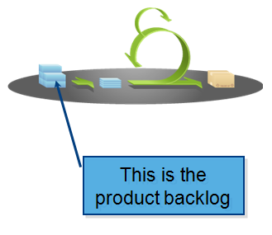
Scrum Artifacts
Product Backlog
The requirements
Desired work on project
Expressed as user stories
Prioritized by product owner
Reprioritized at start of each sprint

Slide 22
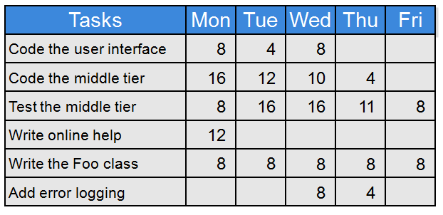
Sprint Backlog

Slide 23
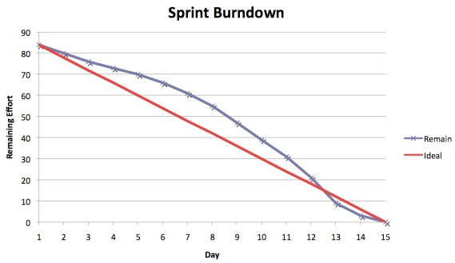
Sprint Burndown Chart
Display of what work has been completed and what is left to complete
one for each work item
Updated everyday
Shows overall progress

Slide 24
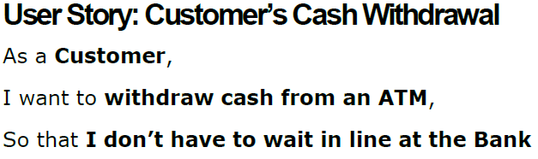
User Story

Slide 25
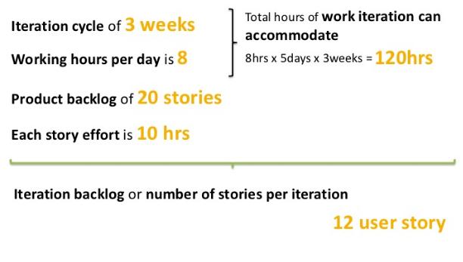
Scrum Planning Example

Slide 26
What do we do in Scrum?
The project is described as a list of features, the backlog
The features are described in terms of user stories
The scrum team estimates the work associated with each story
Features in the backlog are ranked in order of importance
Result is a ranked and weighted list of product features, a roadmap
Daily Scrum meeting to discuss the progress

Slide 27
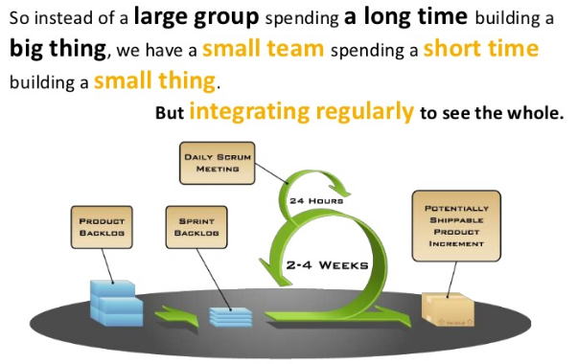
Scrum in a nutshell

Slide 28
Extreme Programming
An agile development methodology
Created by Kent Beck in the mid 1990’s
A set of 12 key practices taken to their “extremes”
A mindset for developers and customers
Four basic activities:
Coding
Testing
Listening
Designing

Slide 29
XP in a nutshell
Writing unit tests before programming and keeping all of the tests running at all times. The unit tests are automated and eliminates defects early, thus reducing the costs
Starting with a simple design just enough to code the features at hand and redesigning when required
Programming in pairs (called pair programming), with two programmers at one screen, taking turns to use the keyboard
Integrating and testing the whole system several times a day
Putting a minimal working system into the production quickly and upgrading it whenever required
Keeping the customer involved all the time and obtaining constant feedback

Slide 30
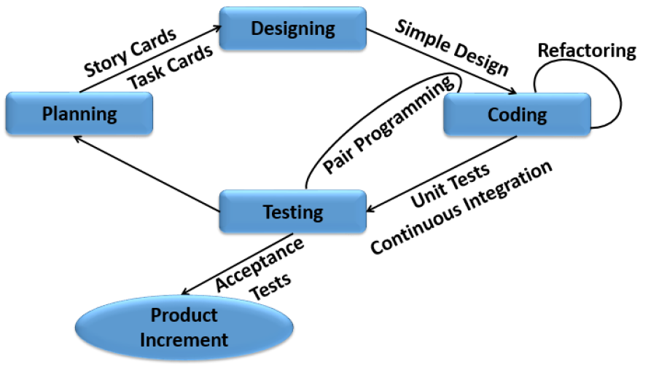
XP

Slide 31
12 Principles
The Planning Game
Small Releases
Metaphor
Simple Design
Testing
Refactoring
Pair Programming
Collective Ownership
Continuous Integration
40-Hour Workweek
On-site Customer
Coding Standards

Slide 32
Planning Game
Planning for the upcoming iteration
Uses stories provided by the customer
Technical persons determine schedules, estimates, costs, etc
A result of collaboration between the customer and the developers

Slide 33
Small Releases
Small in terms of functionality
Less functionality means releases happen more frequently
Support the planning game
Provide frequent feedback
Improves tracking
Reduce chance of overall project slippage

Slide 34
Metaphor
The oral architecture of the system
A common set of terminology
Encourages a common set of terms for the system
Reduction of buzz words and jargon
A quick and easy way to explain the system

Slide 35
Simple Design
Keep everything simple
Do as little as needed, nothing more
Keeping everything simple helps programmers on track

Slide 36
Testing
Easy to produce code with 100 percent test coverage
These programmer tests or unit tests are all collected together
Each time a pair releases code to the repository, every test must run correctly

Slide 37
Refactoring
Continuous design improvement process called ‘refactoring’:
Removal of duplication
Increase cohesion
Reduce coupling
Refactoring is supported by comprehensive testing - customer tests and programmer tests

Slide 38
Pair Programming
Two Developers, One monitor, One Keyboard
One “drives” and the other thinks
Switch roles as needed
All production software is built by two programmers, sitting side by side, at the same machine
All production code is therefore reviewed by at least one other programmer
Research into pair programming shows that pairing produces better code in the same time as programmers working singly
Pairing also communicates knowledge throughout the team

Slide 39
Collective Ownership
The idea that all developers own all of the code
Any pair of programmers can improve any code at any time
No ‘secure workspaces’
All code gets the benefit of many people’s attention
Avoid duplication
Programmer tests catch mistakes
Pair with expert when working on unfamiliar code

Slide 40
Continuous Integration
New features and changes are worked into the system immediately
Teams keep the system fully integrated at all times
Daily, or multiple times a day builds
Avoid ‘integration hell’

Slide 41
40 Hour Week
The work week should be limited to 40 hours
Regular overtime is a symptom of a problem and not a long term solution
Most developers lose effectiveness past 40-Hours
Value is placed on the developers well-being
Management is forced to find real solutions

Slide 42
On-site Customer
Acts to “steer” the project
Gives quick and continuous feedback to the development team
Makes sure that what is developed is what is needed
Functionality is prioritized correctly

Slide 43
Coding Standards
Use common coding standard
All code in the system must look as though written by an individual
Code must look familiar, to support collective code ownership

Slide 44
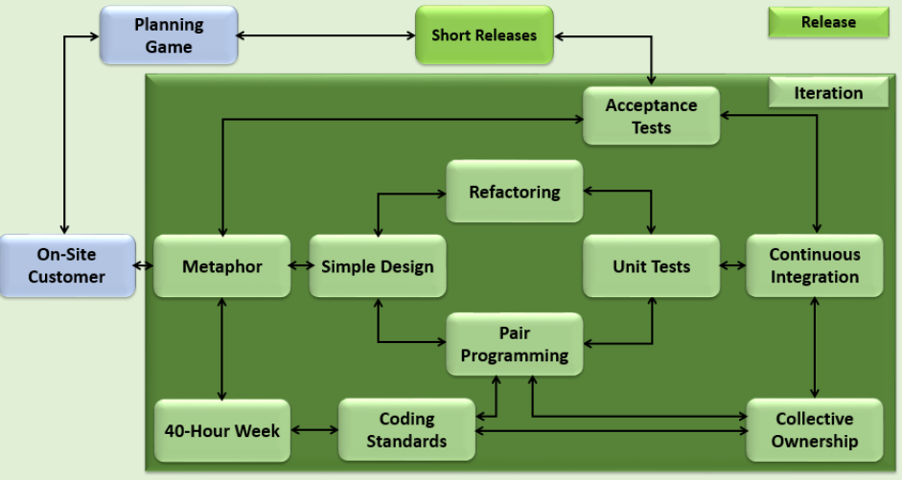
XP

Slide 45
Extreme programming
New approach to development based on the development and delivery of very small increments of functionality
Relies on constant code improvement, user involvement in the development team and pairwise programming
Design of the test suits first !
Then you perform testing of the system after each small increment

Slide 46
What is Kanban?
A Japanese word meaning “Visual cards” to indicate a flow of work earlier used by Toyota to limit the amount of inventory tied up in WIP on a manufacturing floor.
The core concept of Kanban includes:
Visualize Workflow
Split the entire work into segments or states, visualized as named column on a wall
Write each item on a card and put in a column to indicate where the item is in the workflow
Limit WIP
Assign limits to how many items can be in progress at each workflow segment/state i.e. WIP is limited in each workflow state
Measure the Lead Time
Lead time aka cycle time is the average time to complete one item. Measure the Lead time and optimize the process to make the lead time as small and predictable as possible

Slide 47
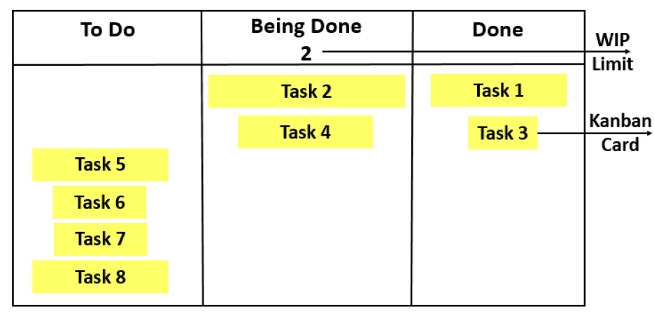
Sample Kanban Board

Slide 48
Agile Kanban
Agile Kanban is Agile software development with Kanban approach
In agile the board is used to visualize workflow, put up on a wall in the project room
Status and progress of the story development tasks is tracked visually on the Kanban board with flowing Kanban cards

Slide 49
Agile Kanban Characteristics
Kanban Board represents all the stories and is updated on a daily basis as the team progresses
Provides easy access to everyone involved in the project
Facilitates communication as and when necessary
Progress of the tasks are visually displayed
Bottlenecks are visible as soon as they occur
Helps team continuously communicate with customer

Slide 50
Agile Kanban Characteristics
WIP Limit
The number associated with the Doing column is WIP limit, the maximum number of tasks that can be in that column at any point in time
Pull Approach
It is used as and when a task is completed in the Doing column and another card is pulled from To Do column
Self-directing
The team is responsible for planning, tracking, reporting and communicating in the project. Taking decisions for completion of project, hence empowering the team

Slide 51
Agile Kanban Characteristics
Continuous Flow
In agile development work flows across different functions without wait-time, hence this contributes minimizing the cycle time of Kanban
Visual Metrics
Metrics are tracked visually using Kanban Board and Burndown Chart

Slide 52
Kanban & Scrum Similarities
Both are Agile
Both use pull scheduling
Both limit WIP, Kanban at task level and Scrum at sprint level
Both use transparency across the development
Both focus on delivering releasable software early
Both are based on self-organizing teams
Both require breaking the work into pieces
In both the methods, the release plan is continuously optimized based on empirical data

